Slide 1
Company & Mobile Strategy

Slide 2
Corporate
Founded: 2007
Employees: 255
Investors: Fidelity Growth Partners, UK
Offices: Hamburg (HQ), Seoul, Sao Paulo
Games: Browser and mobile F2P
Rev 2012: 50 million €

Slide 3
Portfolio
Browser
Mobile

Slide 4
Cross Platform Approach
Why?
Increase in contact
Increase in target group
Player retention
InnoGames method:
web optimized builds to test interest →
high quality apps with full functionality
Current projects:
Forge of Empires on iPad, iPhone
Grepolis on all Android and iOS
2 unannounced cross-platform titles

Slide 5
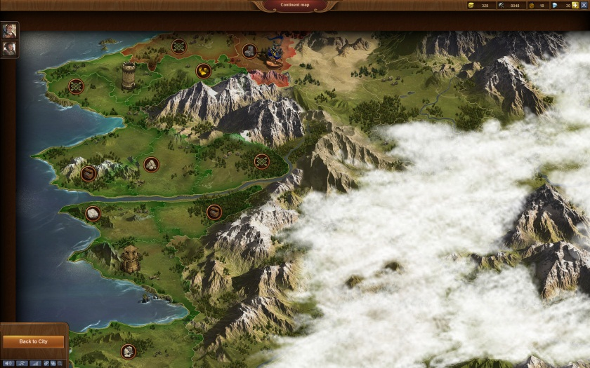
Forge of Empires
Browser Version
Over 10 Million registered users (within 1 year)
25 language versions
Most successful new browser game in 2012
Midcore city-builder – various target groups
Won German Computer Games Award 2013, nominated for German Developer Award, European Games Award

Slide 6
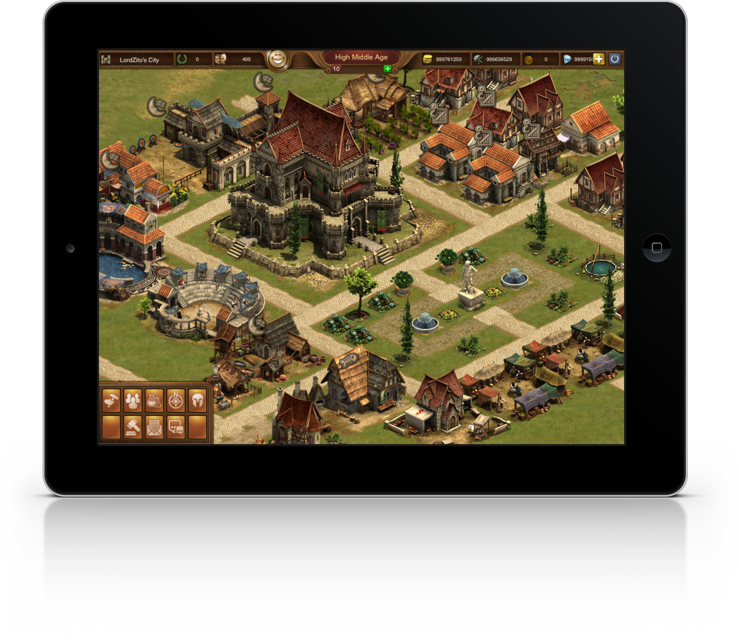
Forge of Empires
iOS-Release
Single Sign-On
Play on several devices with one account
Cross-Platform
Full functionality
Touchscreen - Optimized UI
Direct Play
Technical basis: COCOS2D-X
Release Q4 2013

Slide 7
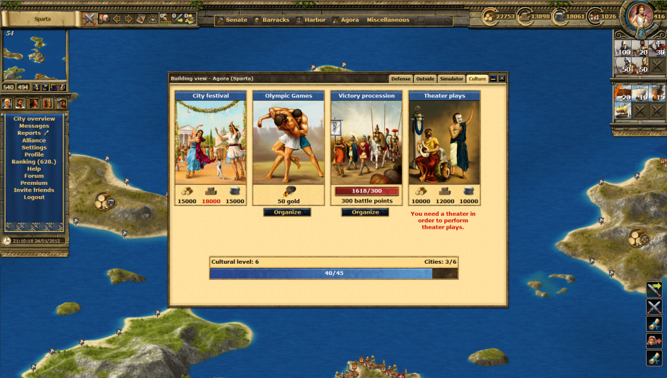
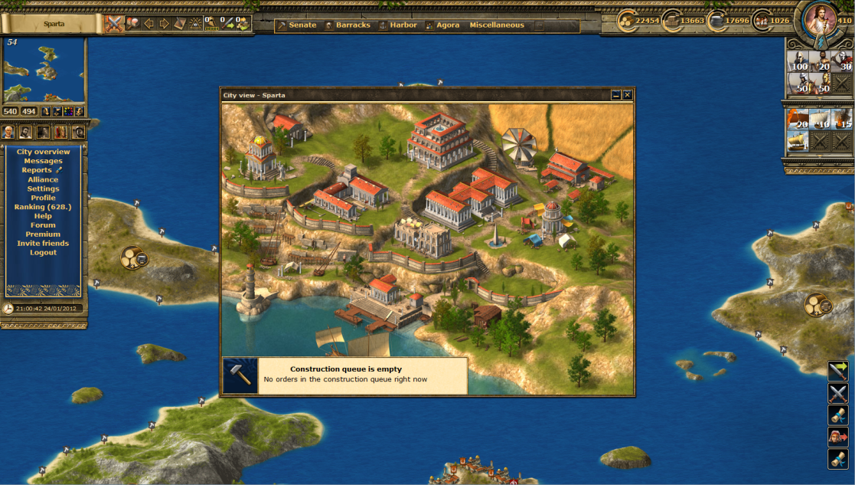
Grepolis
Browser Version
Over 20 million registered users worldwide
Playable in 22 languages
Hardcore – PvP browser game
Activity rewarded
-> App highly demanded by community

Slide 8
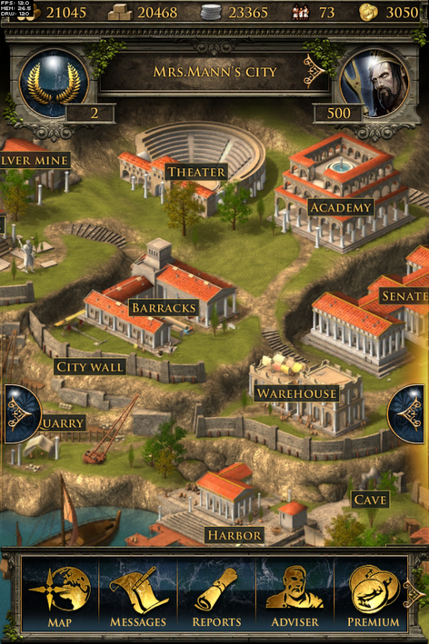
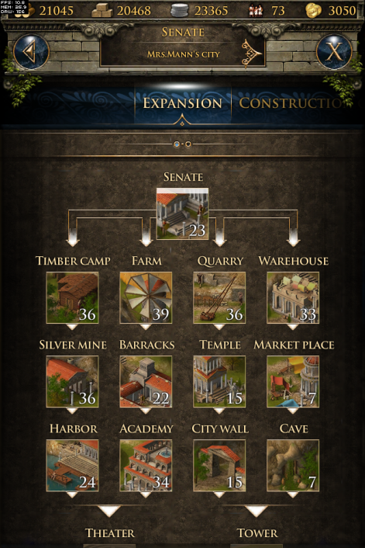
Grepolis
App Release for all Android, iOS devices
Single Sign-On
Play on several devices with one account
Cross-Platform
Full functionality
Touchscreen - Optimized UI
Technical basis: Adobe Air
Release: August/September 2013

Slide 9
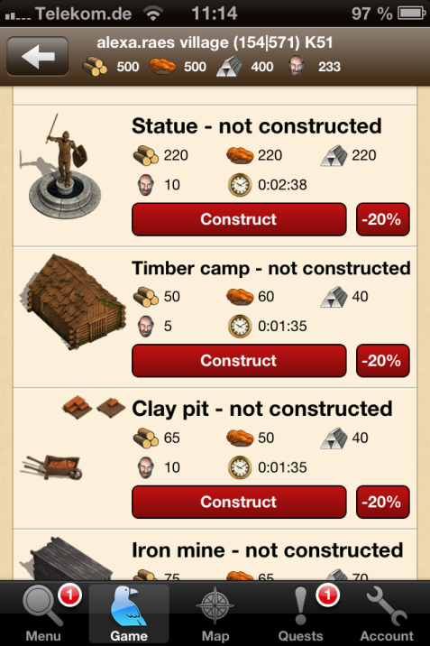
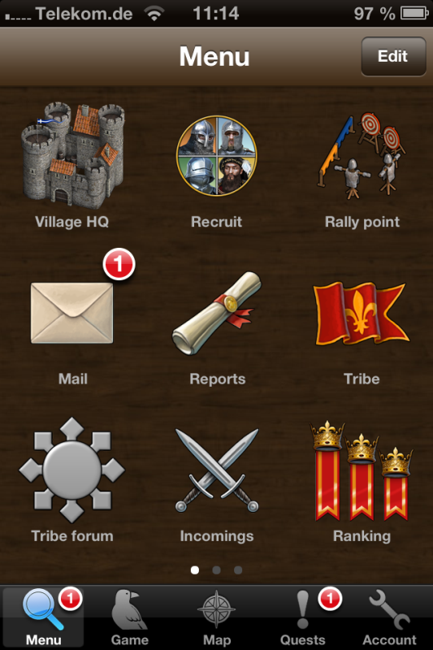
Tribal Wars
App Release for Android, iOS devices
200k regular users
10% of revenue from mobile
iOS native (objective-c), Adobe Air for Android

Slide 10
Thank you for your time!
Dennis Heinert
Head of Public Relations
Tel.: +49 40 788933568
Email: dennis.heinert@innogames.de
Fabio Lo Zito
B2C PR Manager
Tel. +49 40 788 9335107
Email: fabio.lo-zito@innogames.de

